Slide 1
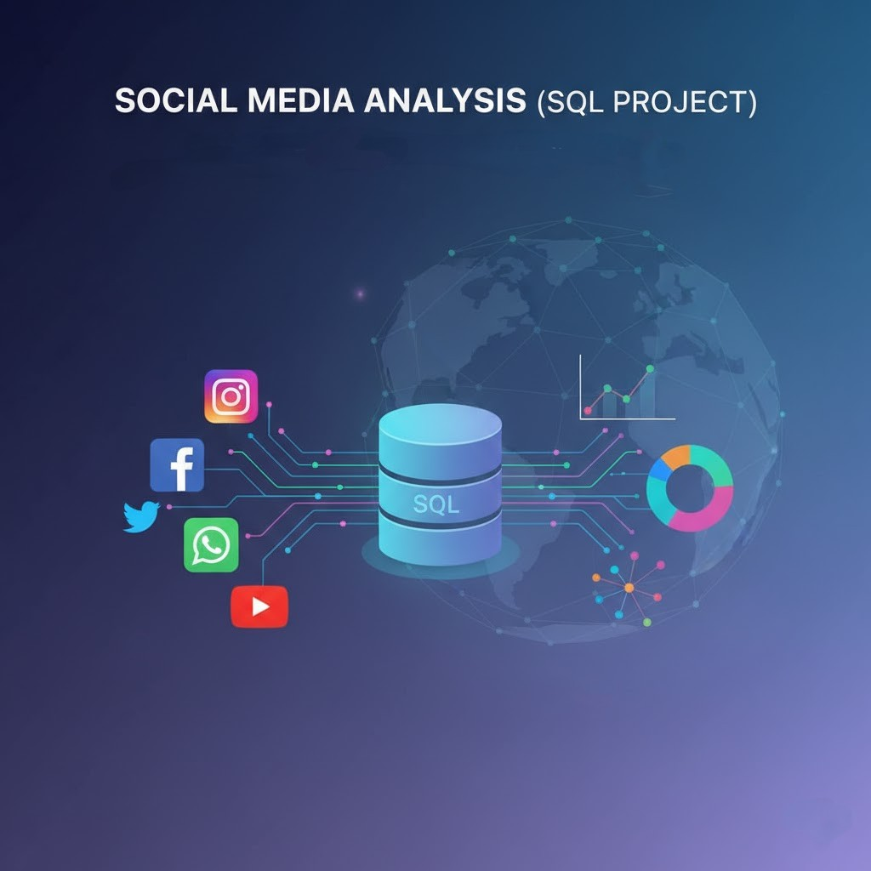
Social Media Analysis (SQL Project)
- Shreyas K

Slide 2


About Meta
Meta, founded by Mark Zuckerberg in 2004 as Facebook, rebranded in 2021 to focus on building the Metaverse a virtual space for social interaction and collaboration. Its products include Facebook, Instagram, WhatsApp, and Oculus, aiming to blend virtual and physical worlds for more connected digital experiences.

Slide 3
Problem Statement
You are hired as a data analyst at Meta and asked to collaborate with Marketing team. Marketing teams wants to leverage Instagram's user data to develop targeted marketing strategies that will increase user engagement, retention, and acquisition. Provide insights and recommendations to address the following objectives

Slide 4
Data Overview
comments_id : unique identifier for each comment
comment_text : text content of a given comment
user_id : unique identifier for each user
photo_id : unique identifier for each photo
created_at : date of interaction in the form like, photos, tags
follower_id : user_id of the follower for a certain user
followee_id : user_id of followee for a certain user
tag_id : unique identifier for each tag
image_url : link to the image posted on the platform
username : username chosen by the user
Users Table : information about users registered on the platform
Photos Table: information about the photos uploaded by users.
Comments Table: Stores all comments made by users on photos.
Likes Table: Tracks which users liked which photos.
Follows Table: Tracks user relationships (followers and followees).
Tags Table: Stores unique tags that are associated with photos.
Photo_Tags Table: connects photos with tags.

Slide 5
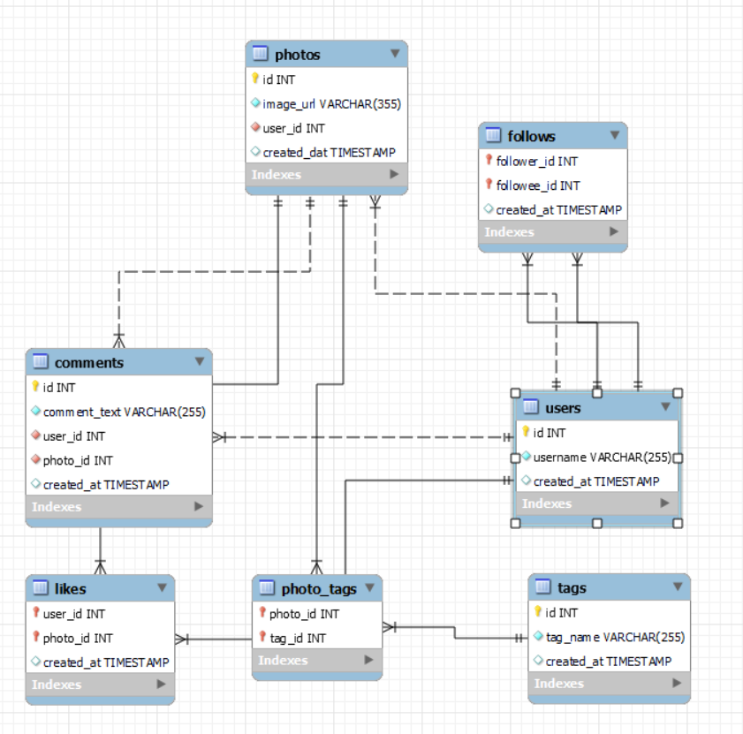
DATABASE SCHEMA

Slide 6
Approach
1.Understanding Problem Statement
Identifying the key questions ,the goals of the analysis, and the data available to address them.
2.Data Cleaning and Validation
Checked and removed duplicates in the data sets also treated null values.
3.Analysis
Utilized SQL functions like CTE ,Aggregate Functions , Subqueries , Group by clause, Rank functions and etc. for analysis.
4.Data Visualization
Visualized key metrics such as total posts, likes, and comments Created charts and graphs to rank users based on engagement rates and to highlight the most influential hashtags.
5.Stagegy Making
Prepared plans and strategies for increasing user retention and increasing engagement activity.
6.Implementation
Implementation of the plans and strategy are also discussed for optimised and better results.

Slide 7
User Classification
Out of 100 users there are only 30% of Active Users.
34 % of users are Moderate Active Users.
Inactive Users are the those users who have very low engagement rate and they are 34 %.

Slide 8
There are total 100 users.
There users who created their account before 2017 are considered as Old Users else New Users.
65% of users are Old Users and 35 % of users are New Users.

Slide 9
User Activity On Photos
Out of 100 users only 74 users post the photo.
The majority (18) of users have only 1 post .
Only 7 users are posting photos more than 5.
As the number of post increases ,the user count decreases significantly.
The chart shows the data of Total number of Posts for Users.
The Hashtags with the highest engagement rate are:
1.beauty 2.delicious 3.foodie 4.dreamy
5.food 6.photography 7.smile 8.stunning
9.sunset 10.beach

Slide 10
User Activity On Likes
The chart shows the Number of Likes for each User.
13 users have 257 likes which is the highest Number of Likes among all of the users.
Majority of users have less than 100 likes.
23 users have no like out of 100 users.

Slide 11
User Activity On Comments
The chart shows the Number of Comments for each User.
13 users have made 257 comments which is the highest number of comments made by an user.
Majority of users have less than 90 comments.
23 users have no comments out of 100 users.
These numbers can affect the engagement rate

Slide 12
Engagement Rate
The Engagement Rate is calculated by the sum of Number of Likes and Number of Comments for each User.
There is need of making the user experience better in order to increase average engagement rate.
The chart shows top 20 engaged users among total 100 users.
Majority of users have less than 70 average engagement rate.

Slide 13
Strategic Recommendations
Content Strategy
Focus on food, lifestyle, and nature themes.
Use high-performing hashtags like #foodie and #photography for better reach.
Timing Strategy
Peak engagement: around 10 AM — schedule posts and campaigns accordingly.
Influencer Strategy
Collaborate with micro-influencers (Florence99, Eveline95) for authentic, high-engagement campaigns.
User Segmentation
Creators: Provide visibility tools and analytics.
Passive Users: Nudge with relevant content suggestions.
Engagers: Encourage continued interaction through recognition or rewards.
Dormant Users: Run re-engagement campaigns or personalized outreach.

Slide 14
Conclusion
SQL analysis turned raw data into actionable insights.
Identified top influencers, peak engagement times, and trending content.
Data → Insights → Strategy → Better Campaigns → Growth.
Data-driven decisions can power engagement and guide marketing success
Making reels should be promoted among users and influencers should be motivated to make reels related to trending hashtags.
Ads and Campaigns should be optimize with trends.
Promotion through notification should be done via tests and mails.

